Slide 1
Flash tool via MK20

Slide 2
Outline
Switch MBED serial driver
Attached Driver

Slide 3
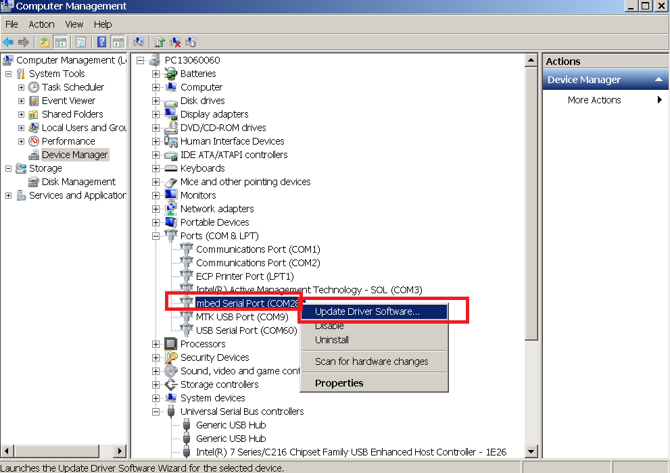
Switch MBED serial driver (1/7)
Step 1:select “update driver software”

Slide 4
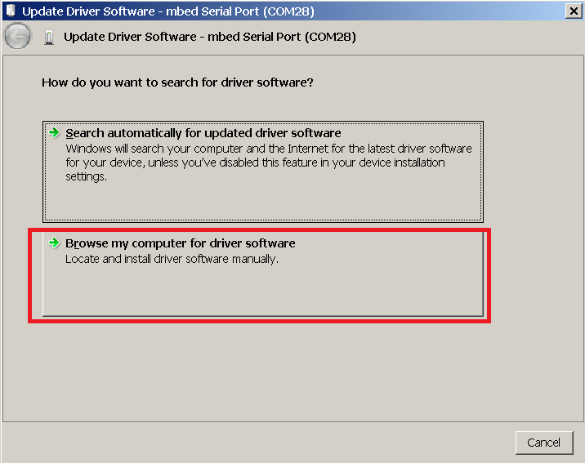
Switch MBED serial driver (2/7)
Step 2:select “Browse my computer for driver software”

Slide 5
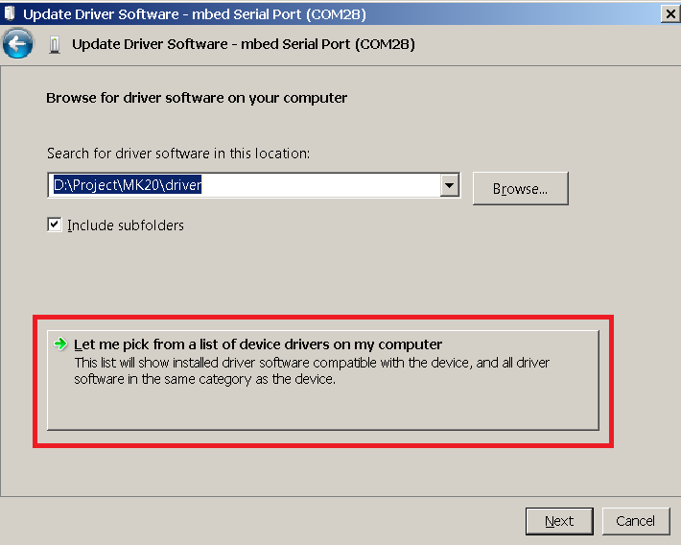
Switch MBED serial driver (3/7)
Step 3: select “Let me pick from a list of device drivers on my computer”

Slide 6
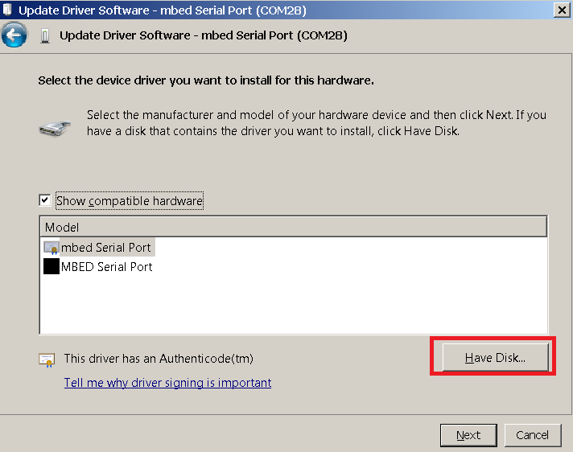
Switch MBED serial driver (4/7)
Step 4: select “Have Disk” and point to where serial.inf is.

Slide 7
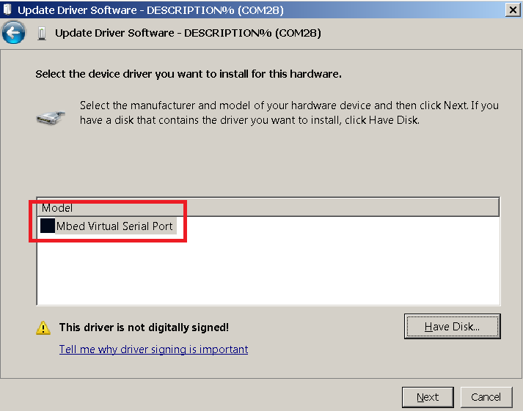
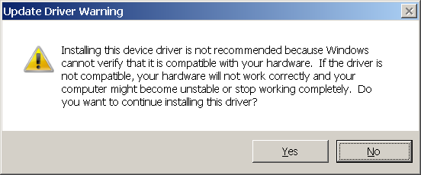
Switch MBED serial driver (5/7)
Step 5: select “DESCRIPTION%”,
Step 6: select “Yes”

Slide 8
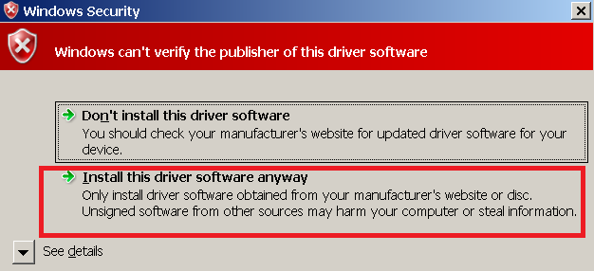
Switch MBED serial driver (6/7)
Step 7: select “install this driver anyway”.

Slide 9
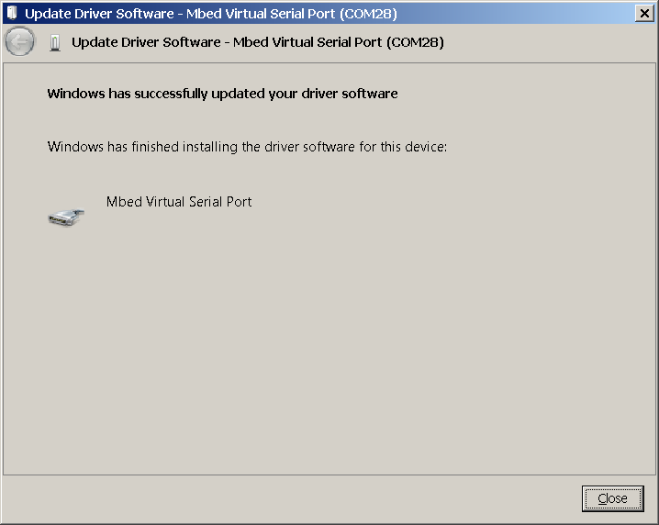
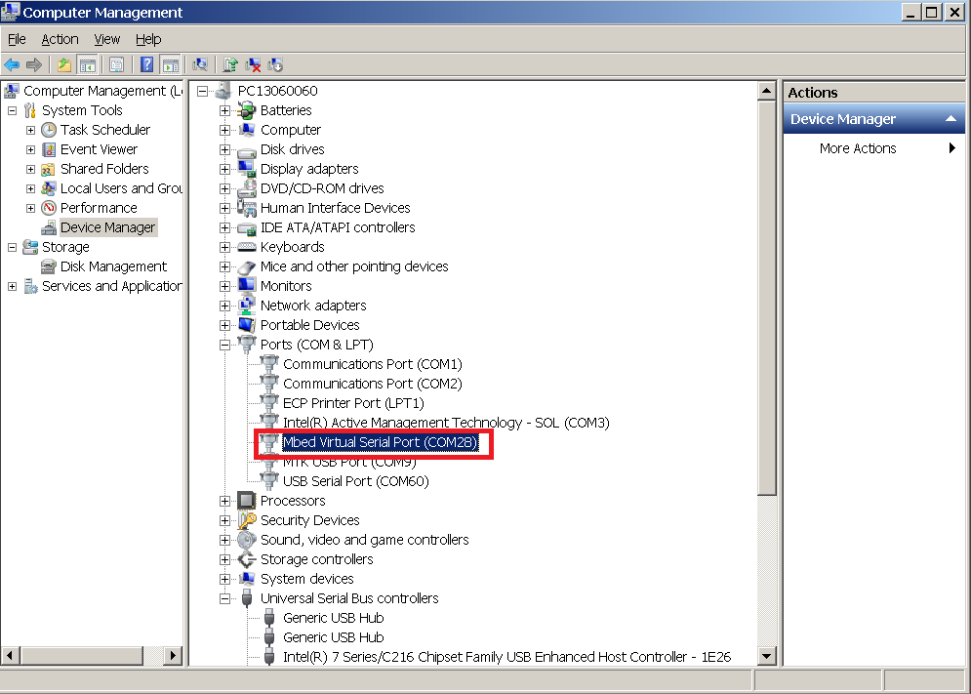
Switch MBED serial driver (7/7)
Step 8: Done. (Found “mbed virtual serial port”) (If the com port still can not work, please reboot PC and try again.)

Slide 10
Attached Driver
Driver file:

